Slide 1

WEB FRAMEWORKS E-CART – USING DJANGO
BY
SIVA GIRISH
PARSHVA B JAIN

Slide 2

DESCRIPTION
OUR WEBSITE BEGINS WITH A LOGIN PAGE IN CASE THE USER HAS REGISTERED.
THE LOGIN PAGE HAS A LINK TO SIGNUP PAGE WHERE THE USER ENTERS THE REQUIRED DETAILS AND REGISTER’S AS A USER OF OUR WEB APPLICATION.
THE HOME PAGE CONTAINS CATALOUGE OF VARIOUS T-SHIRTS AND THEIR PRICE WHICH ARE RETRIEVED FROM THE DATABASE PROVIDED BY DJANGO (SQLITE).
AFTER USER HAS ADDED THE REQUIRED ITEMS IN HIS CART. UPON CLICKING PROCEED TO CHECKOUT ,HE IS ALERTED WITH THE TOTAL AMOUNT TO BE PAID AND A LIST OF ALL ITEM’S BOUGHT.

Slide 3
LINK FOR THE WEBSITE
sivagirish81.pythonanywhere.com
GO TO WEBSITE

Slide 4
CONTRIBUTION OF TEAM MEMBERS
PARSHVA B JAIN:
Created the login form.
The Database for the login form.
CSS for the login form.
Feedback Form
SIVA GIRISH:
Designed the Cart Page of the website.
Designed the database for the cart page.
Designed the backend functionality to read from the database and display on the website.
Designed the Registration Form.
WE DEPLOYED THE WEBSITE TOGETHER ON PYTHONANYWHERE.

Slide 5

SCREENSHOTS

Slide 6
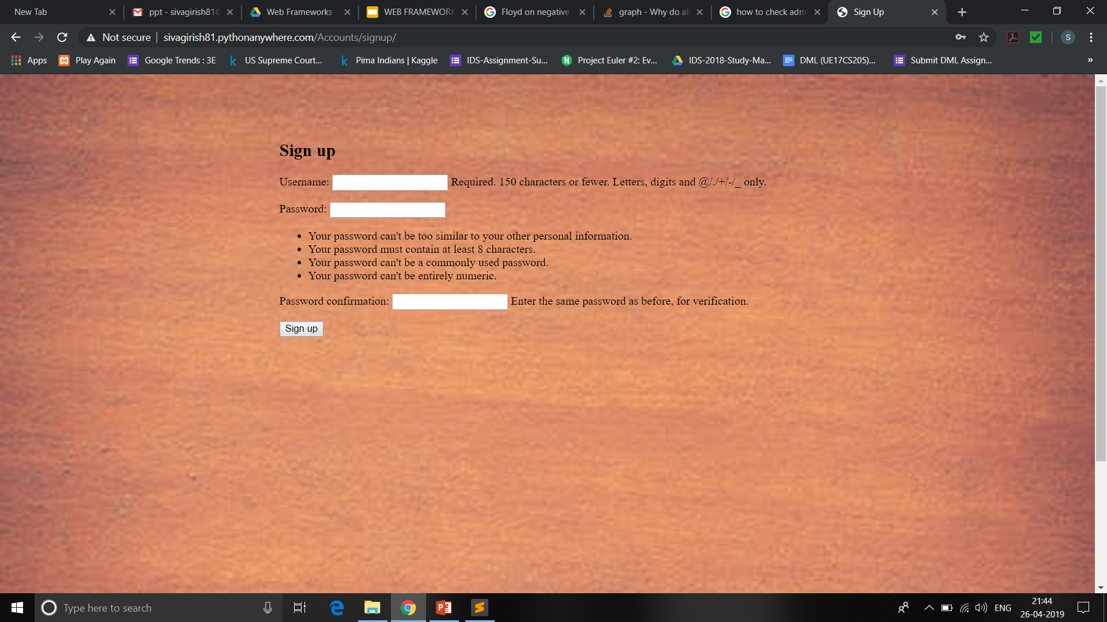
SCREENSHOTS

Slide 7
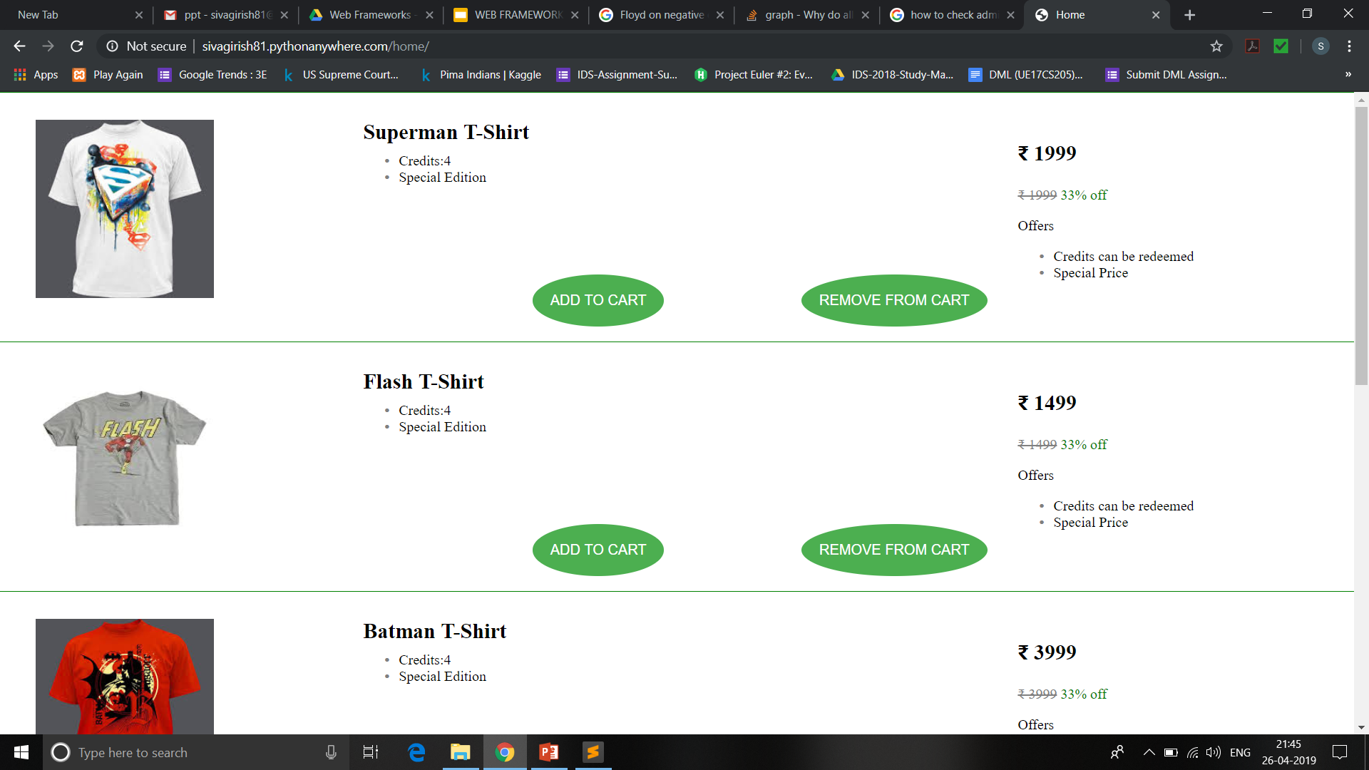
SCREENSHOTS

Slide 8
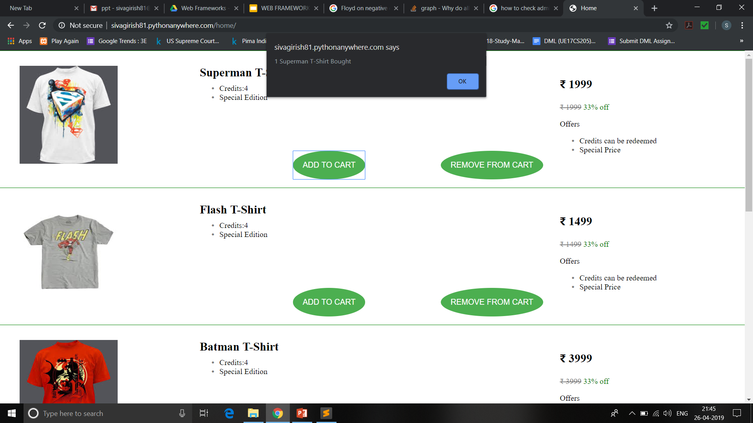
SCREENSHOTS

Slide 9
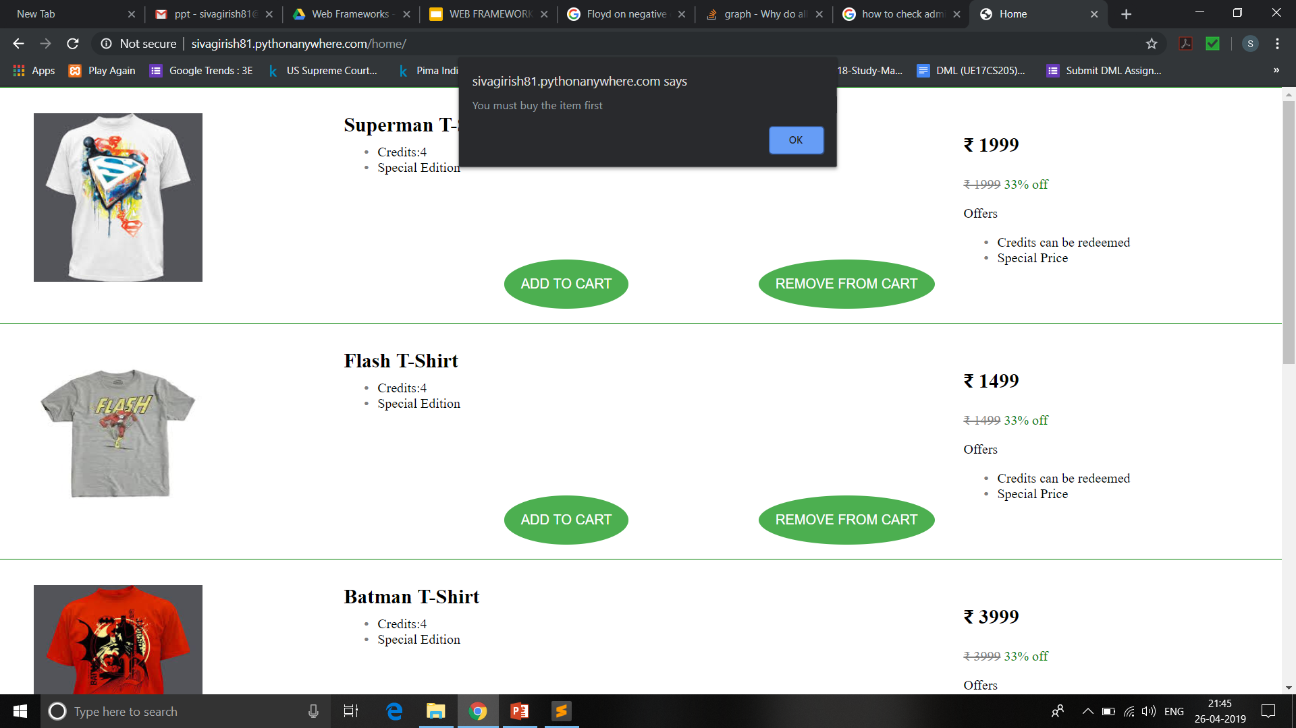
SCREENSHOTS

Slide 10

SCREENSHOTS

Slide 11
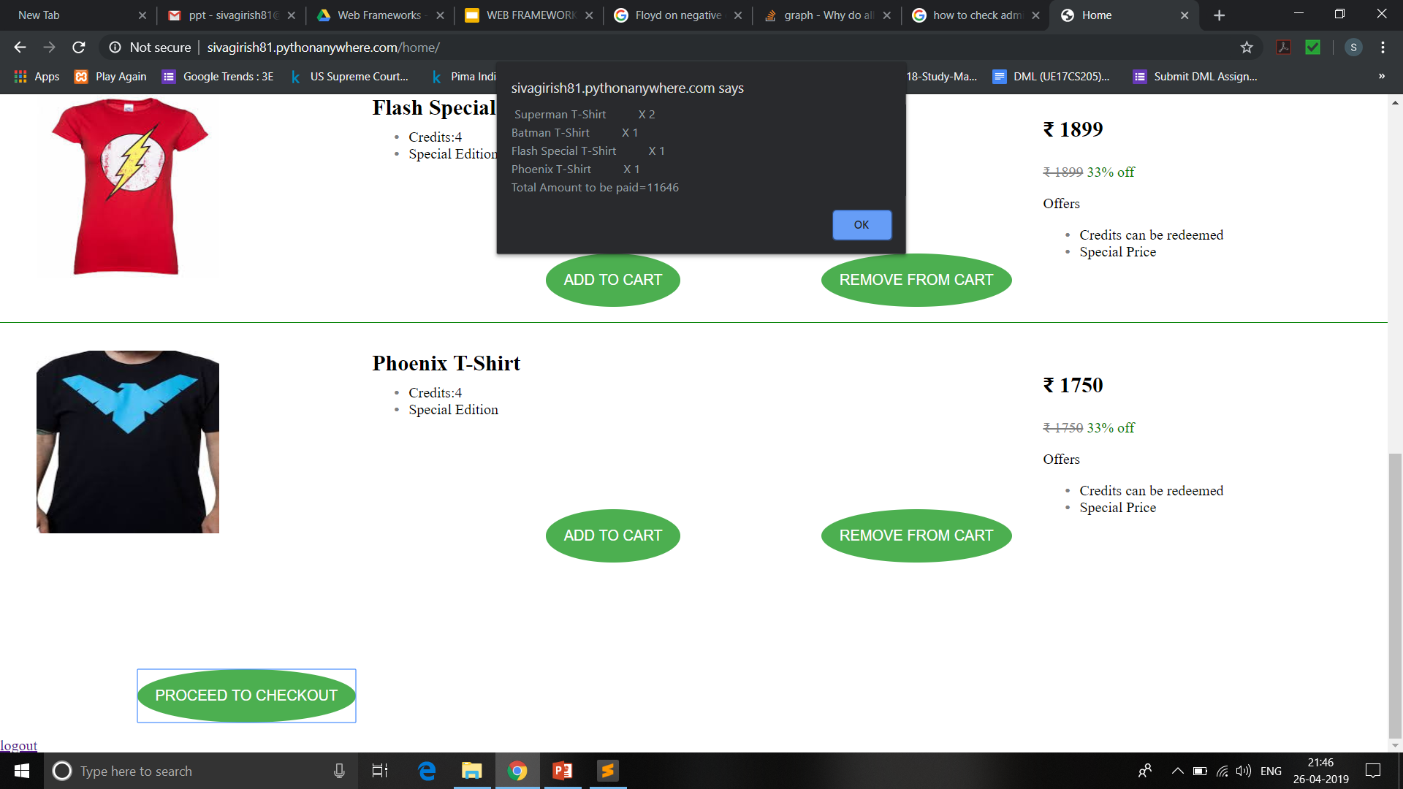
SCREENSHOTS

Slide 12
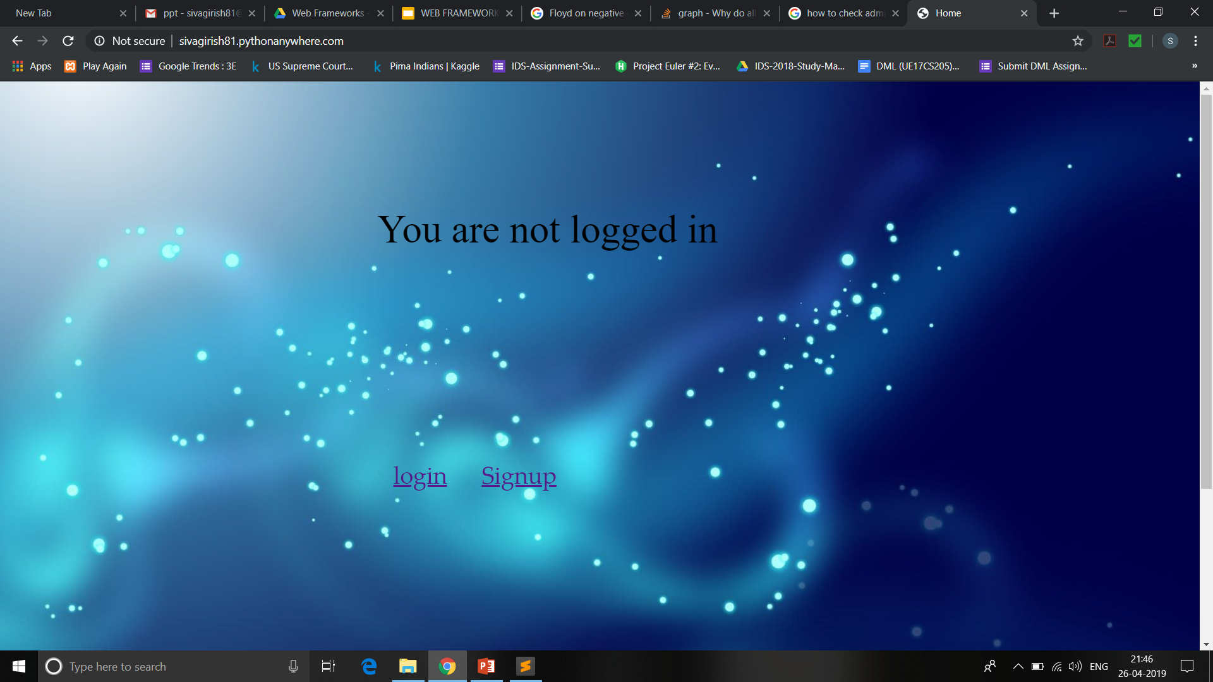
SCREENSHOTS

Slide 13
TAKEAWAYS
LEARNT HOW TO CREATE LOGIN/LOGOUT INTERFACE USING DJANGO.
LEARNT TO UPLOAD IMAGES ONTO THE DATABASE USING IMAGEFIELD.
LEARNT HOW TO RETRIEVE DATA FROM DATABASE AND DISPLAY INTO TEMPLATES.
LEARNT TO CREATE A FULL FLEDGED REGISTRATION FORM FROM SCRATCH.

Slide 14
CHALLENGES
WE WANTED TO USE SESSION CONCEPT FOR RECORDING THE USERS PRODUCT SUMMARY.
WE CREATED FEEDBACK FORM BUT WERE UNABLE TO DEPLOY IT ON OUR WEB APP.
WE WANTED TO INSERT THE IMAGE LINK INTO THE DATABASE , SINCE WE WERE UNABLE TO DO THAT WE HAD TO UPLOAD IMAGES USING IMAGEFIELD AND THEN HAD TO DISPLAY IT INSIDE RESPECTIVE TEMPLATES.

Slide 15
CONTACT INFO
NAME : PARSHVA B JAIN
USN: PES1201701336
EMAIL: pashwab255225@gmail.com
NAME: SIVA GIRISH
USN: PES1201700159
EMAIL: sivagirish81@gmail.com

